Slide 1



PROGRESS REPORT
DISTRICT –
REGION
, 2023

Slide 2
District Overview
Taluka | Category | No. of Schemes |  | Work Order Issued |  | Work In Progress |  | Work Not Started
 |  | PMC | TSP | PMC | TSP | PMC | TSP | PMC | TSP
Buldhana | Retro | 4 | 8 | 4 | 8 | 0 | 6 | 4 | 2
 | New | 0 | 19 |  | 19 | 0 | 16 | 0 | 3
Chikhali | Retro | 8 | 9 | 8 | 8 | 3 | 3 | 5 | 5
 | New | 0 | 0 |  |  | 0 | 0 | 0 | 0
Deulgaon Raja | Retro | 9 | 2 | 6 | 2 | 0 | 1 | 6 | 1
 | New | 0 | 12 |  | 11 | 0 | 6 | 0 | 5
Khamgaon | Retro | 12 | 20 | 10 | 18 | 0 | 12 | 10 | 6
 | New | 2 | 5 | 2 | 5 | 0 | 5 | 2 | 0
Lonar | Retro | 0 | 1 |  | 1 | 0 | 0 | 0 | 1
 | New | 0 | 23 |  | 21 | 0 | 17 | 0 | 4
Malkapur | Retro | 0 | 15 |  | 15 | 0 | 13 | 0 | 2
 | New | 0 | 4 |  | 4 | 0 | 4 | 0 | 0
Mehakar | Retro | 0 | 7 |  | 7 | 0 | 1 | 0 | 6
 | New | 0 | 38 |  | 36 | 0 | 11 | 0 | 25

Slide 3
District Overview
Taluka | Category | No. of Schemes |  | Work Order Issued |  | Work In Progress |  | Work Not Started
 |  | PMC | TSP | PMC | TSP | PMC | TSP | PMC | TSP
Motala | Retro | 0 | 21 |  | 21 | 0 | 19 | 0 | 2
 | New | 0 | 2 |  | 2 | 0 | 2 | 0 | 0
Nandura | Retro | 2 | 16 | 1 | 16 | 0 | 13 | 1 | 3
 | New | 0 | 3 |  | 3 | 0 | 3 | 0 | 0
Sindkhed Raja | Retro | 10 | 6 | 4 | 6 | 0 | 1 | 4 | 5
 | New | 0 | 7 |  | 7 | 0 | 1 | 0 | 6
Total | Retro | 45 | 105 | 33 | 102 | 3 | 69 | 30 | 33
 | New | 2 | 113 | 2 | 108 | 0 | 65 | 2 | 43
Grand Total |  | 47 | 218 | 35 | 210 | 3 | 134 | 32 | 76
 |  | 265 |  | 245 |  | 137 |  | 108

Slide 4
Executive Summary Work in Progress Schemes
Taluka | Category | No. of Schemes | No. of Schemes based on Physical Progress %
 |  |  | < 25% | 25 < 50% | 50 < 75% | 75 < 100% | Commissioned
Buldhana | Retro | 6 | 1 | 0 | 1 | 3 | 1
 | New | 16 | 10 | 3 | 1 | 2 | 0
Chikhali | Retro | 6 | 4 | 1 | 0 | 0 | 1
 | New | 0 | 0 | 0 | 0 | 0 | 0
Deulgaon Raja | Retro | 1 | 1 | 0 | 0 | 0 | 0
 | New | 6 | 4 | 1 | 0 | 1 | 0
Khamgaon | Retro | 12 | 5 | 3 | 2 | 2 | 0
 | New | 5 | 2 | 0 | 2 | 1 | 0
Lonar | Retro | 0 | 0 | 0 | 0 | 0 | 0
 | New | 17 | 13 | 1 | 1 | 2 | 0
Malkapur | Retro | 13 | 5 | 3 | 3 | 2 | 0
 | New | 4 | 3 | 0 | 1 | 0 | 0
Mehakar | Retro | 1 | 0 | 0 | 1 | 0 | 0
 | New | 11 | 8 | 2 | 1 | 0 | 0

Slide 5
Executive Summary Work in Progress Schemes
Taluka | Category | No. of Schemes | No. of Schemes based on Physical Progress %
 |  |  | < 25% | 25 < 50% | 50 < 75% | 75 < 100% | Commissioned
Motala | Retro | 19 | 0 | 3 | 11 | 5 | 0
 | New | 2 | 0 | 0 | 0 | 1 | 1
Nandura | Retro | 13 | 10 | 3 | 0 | 0 | 0
 | New | 3 | 3 | 0 | 0 | 0 | 0
Sindkhed Raja | Retro | 1 | 0 | 0 | 0 | 1 | 0
 | New | 1 | 0 | 1 | 0 | 0 | 0
Total | Retro | 72 | 26 | 13 | 18 | 13 | 2
 | New | 65 | 43 | 8 | 6 | 7 | 1
Grand Total |  | 137 | 69 | 21 | 24 | 20 | 3

Slide 6
Abstract of Schemes – Work in Progress Category – “Retro”
Sr No | Scheme Name | Name of Agency | W.O. Amount (excl GST) | W.O. Date | Construction Period | Physical Progress | RA Bill (Recommended) % | RA Bill (Recommended) In Lakhs
Buldhana Taluka | Buldhana Taluka
1 | Jamb | Anant Dinkar Jadhav | 90,95,237 | 23-06-2022 | 18 Months | 93.02% | - | -
2 | Tandulwadi | Prabhakar Dattu Rane | 1,37,79,457 | 24-02-2022 | 24 Months | 86.05% | - | -
3 | Kumbephal | Shivkrupa Construction | 1,02,96,140 | 01-08-2022 | 18 Months | 76.90% | - | -
4 | Birshingpur | Om Bahekar | 76,86,987 | 06-02-2022 | 18 Months | 61.21% | - | -
5 | Satgaon(Mhasla) | Abhay B. ingle | 88,21,872 | 15-03-2022 | 18 Months | 9.72% | - | -
Chikhali Taluka | Chikhali Taluka
6 | Bharosa | Nitin Narayan Surve | 1,40,36,731 | 25-03-2022 | 24 Months | 34.32% | - | -
7 | Undri | Kailas Solanke | 2,49,48,762 | 11-08-2021 | 18 Months | 16.71% | - | -
8 | Malagi | Nitin Ramchandra Surve | 71,84,808 | 18-08-2022 | 18 Months | 4.81% | - | -
9 | Pandhardeo | Kureshi Shoab Raja A. munaf | 39,65,293 | 21-12-2022 | 12 Months | 4.22% | - | -
10 | Palaskhed | Ajay Singh Bhagvatsingh Jayvar | 1,29,10,807 | 25-07-2022 | 12 Months | 1.25% | - | -
Deulgaon Raja Taluka | Deulgaon Raja Taluka
11 | Bhivgaon-Jumba | Balaji Builder and Developer | 1,92,22,923 | 16-06-2022 | 12 Months | 16.02% | - | -

Slide 7
Abstract of Schemes – Work in Progress Category – “Retro”
Sr No | Scheme Name | Name of Agency | W.O. Amount (excl GST) | W.O. Date | Construction Period | Physical Progress | RA Bill (Recommended) % | RA Bill (Recommended) In Lakhs
Khamgaon Taluka | Khamgaon Taluka
12 | Nipana | Abhay B. Ingle | 2,70,89,174 | 25-03-2022 | 24 Months | 98.04% | - | -
13 | Garadgaon | Abhay B. Ingle | 1,20,72,478 | 21-03-2022 | 12 Months | 75.16% | - | -
14 | Nandari & Bothan | A. Munaf A. Jafur | 2,12,59,379 | 15-03-2022 | 24 Months | 74.40% | - | -
15 | Wadi | Laxman J. Deshmukh | 3,72,88,789 | 17-03-2022 | 24 Months | 63.43% | - | -
16 | Hingna Karegaon | Abhay Ingle | 1,50,38,386 | 15-03-2022 | 24 Months | 39.92% | - | -
17 | Geru Matergaon | Abhay B. Ingle | 97,78,960 | 14-09-2022 | 12 Months | 34.21% | - | -
18 | Tembhurna | Laxman J. Deshmukh | 3,09,11,907 | 14-03-2022 | 24 Months | 31.13% | - | -
19 | Mathani | Abhay B. Ingle | 1,27,38,024 | 23-06-2022 | 18 Months | 24.25% | - | -
20 | Hiwra Khurd | Abhay B. Ingle | 77,41,018 | 09-05-2022 | 9 Months | 21.83% | - | -
21 | Ganeshpur | Abhay B. Ingle | 1,85,21,125 | 17-03-2022 | 18 Months | 15.55% | - | -
22 | Takli iwra | Abhay Ingle | 54,07,975 | 14-09-2022 | 12 Months | 9.28% | - | -
23 | Kanzara | Laxman J. Deshmukh | 2,54,02,000 | 21-03-2022 | 24 Months | 5.92% | - | -

Slide 8
Abstract of Schemes – Work in Progress Category – “Retro”
Sr No | Scheme Name | Name of Agency | W.O. Amount (excl GST) | W.O. Date | Construction Period | Physical Progress | RA Bill (Recommended) % | RA Bill (Recommended) In Lakhs
Malkapur Taluka | Malkapur Taluka
24 | Panhera | Atul Engineering Servises | 4,78,01,900 | 19-05-2022 | 24 Months | 99.04% | - | -
25 | Deodhaba | P.D.Rane | 70,52,326 | 21-06-2022 | 18 Months | 98.81% | 96.50% | 68.05
26 | Pimpalkhuta malkapur | P.D. Rane | 95,82,264 | 21-06-2022 | 18 Months | 68.26% | - | -
27 | Harsoda | Rahul Mitkari | 1,05,57,767 | 02-06-2022 | 18 Months | 66.35% | - | -
28 | Dudhalgaon | P.D.Rane | 4,55,45,381 | 10-05-2022 | 24 Months | 57.36% | - | -
29 | Wadoda | Atul Engineering Services | 1,65,93,268 | 01-08-2022 | 18 Months | 49.72% | - | -
30 | Wadji | Anant Dinkar Jadhav | 81,22,909 | 28-07-2022 | 12 Months | 49.33% | - | -
31 | Narwel | P.D. Rane | 4,11,28,163 | 08-04-2022 | 18 Months | 27.50% | - | -
32 | Wakodi | P. D. Rane | 1,70,60,725 | 21-06-2022 | 18 Months | 19.96% | - | -
33 | Lasura | Atul Engineering Servises | 1,78,22,403 | 05-10-2022 | 18 Months | 16.95% | - | -
34 | Anurabad | Mr. Rahul Mitkari | 62,14,511 | 02-06-2022 | 12 Months | 15.63% | - | -
35 | Morkhed | Atul Engineering Servises | 1,81,45,197 | 10-05-2022 | 18 Months | 15.01% | - | -
36 | RR Datala | Atul Engineering Servises | 4,43,99,116 | 10-05-2022 | 24 Months | 10.38% | - | -

Slide 9
Abstract of Schemes – Work in Progress Category – “Retro”
Sr No | Scheme Name | Name of Agency | W.O. Amount (excl GST) | W.O. Date | Construction Period | Physical Progress | RA Bill (Recommended) % | RA Bill (Recommended) In Lakhs
Mehakar Taluka | Mehakar Taluka
37 | Nagapur | Dhananjay Humbal | 1,17,71,026 | 03-09-2022 | 18 Months | 71.15% | - | -
Motala Taluka | Motala Taluka
38 | Parda & 4 Villages | P..D. rane | 1,88,91,114 | 23-06-2022 | 18 Months | 97.44% | - | -
39 | Khedi | Shivparvati Construction | 40,99,806 | 15-02-2022 | 12 Months | 95.67% | - | -
40 | Wagjal | P. D. Rane | 94,19,944 | 01-08-2022 | 18 Months | 91.86% | - | -
41 | Avha | P.D. Rane | 4,92,01,159 | 12-05-2022 | 24 Months | 85.16% | - | -
42 | Murti | P.D. Rane | 1,62,19,736 | 05-06-2022 | 18 Months | 77.52% | - | -
43 | Ridhora | Shivparvati Construction | 26,14,242 | 15-02-2022 | 12 Months | 74.22% | - | -
44 | Urha | Shiv Parvati Construction | 65,50,960 | 23-06-2022 | 12 Months | 69.08% | - | -
45 | Thad | Anant Dinkar Jadhav | 88,41,913 | 23-06-2022 | 18 Months | 65.96% | - | -
46 | Panhera | Shivparvati Construction | 1,31,84,775 | 17-03-2022 | 18 Months | 64.97% | - | -
47 | Sinkhed | Shiv Parvati construction | 1,22,79,147 | 09-05-2022 | 18 Months | 62.10% | - | -
48 | Lapali | Shiv Parvati Construicton | 1,00,32,409 | 27-06-2022 | 18 Months | 60.54% | - | -
49 | Liha BK | P.D. Rane | 89,37,815 | 25-03-2022 | 12 Months | 60.21% | - | -

Slide 10
Abstract of Schemes – Work in Progress Category – “Retro”
Sr No | Scheme Name | Name of Agency | W.O. Amount (excl GST) | W.O. Date | Construction Period | Physical Progress | RA Bill (Recommended) % | RA Bill (Recommended) In Lakhs
50 | Mahalungi-Vadgaon | Prabhakar Dattu Rane | 1,53,73,843 | 24-02-2022 | 24 Months | 57.83% | - | -
51 | Pimpalgaon Devi | P.D.Rane | 1,82,73,380 | 05-12-2022 | 18 Months | 55.11% | - | -
52 | Chinchpur | Anant Dinkar Jadhav | 64,37,354 | 27-06-2022 | 12 Months | 54.19% | - | -
53 | Kolhi Golar | P.D. Rane | 1,86,62,772 | 23-06-2022 | 18 Months | 54.09% | - | -
54 | Dhamangaon | Anant Dinkar Jadhav | 2,58,83,985 | 23-06-2022 | 18 Months | 46.16% | - | -
55 | Shelgaon | P.D. Rane | 1,73,09,757 | 27-06-2022 | 18 Months | 45.47% | - | -
56 | Kinhala | P.D. Rane | 82,02,918 | 25-03-2022 | 18 Months | 40.38% | - | -
Nandura Taluka | Nandura Taluka
57 | Narkhed | Mr.Rahul Mitkari | 81,25,334 | 20-06-2022 | 18 Months | 36.26% | - | -
58 | Takarkhed | Atul Engineering Servises | 1,72,36,301 | 18-05-2022 | 24 Months | 28.50% | - | -
59 | Pimpari | Atul Engineering Services | 79,37,888 | 25-07-2022 | 12 Months | 25.84% | - | -
60 | Wasadi (Bk) | Atul Engineering Servises | 88,27,055 | 24-06-2022 | 12 Months | 24.11% | - | -
61 | Takarked | Atul engineering Servises | 1,72,96,301 |  | 24 Months | 22.54% | - | -
62 | Jawal Bazar | Ajaysingh Bhagwatsingh Jaywar | 61,16,920 | 25-05-2022 | 12 Months | 15.57% | - | -

Slide 11
Abstract of Schemes – Work in Progress Category – “Retro”
Sr No | Scheme Name | Name of Agency | W.O. Amount (excl GST) | W.O. Date | Construction Period | Physical Progress | RA Bill (Recommended) % | RA Bill (Recommended) In Lakhs
63 | Tandulwadi | Ajaysingh Bhagwatsingh Jaywar | 1,06,52,729 | 25-07-2022 | 18 Months | 9.91% | - | -
64 | Mendhali | Ajaysingh Bhagwatsingh Jaywar | 74,56,728 | 25-07-2022 | 12 Months | 9.69% | - | -
65 | Wadner | Atul engineering Servises | 4,20,74,102 | 05-10-2022 | 24 Months | 8.09% | - | -
66 | Potali | Ajaysing Bhagavatsing Jaywar | 1,19,87,927 | 08-01-2022 | 12 Months | 7.32% | - | -
67 | Mahalungi | Ajaysingh Bhagwatsingh Jaywar | 1,13,84,401 | 25-07-2022 | 12 Months | 2.38% | - | -
68 | Tarwadi, Bhorwand, Pota & Kandari Bk | Atul Engineering Servises | 3,88,52,931 | 27-06-2022 | 18 Months | 1.84% | - | -
69 | Khaira | Atul Engineering Servises | 1,02,01,838 | 27-06-2022 | 18 Months | 0.87% | - | -
Sindkhed Raja | Sindkhed Raja
70 | Hanwatkhed | Shivanand Narayan Munde | 63,89,024 | 08-03-2022 | 18 Months | 87.75% | - | -

Slide 12
Abstract of Schemes – Work in Progress Category – “New”
Sr No | Scheme Name | Name of Agency | W.O. Amount (excl GST) | W.O. Date | Construction Period | Physical Progress | RA Bill (Recommended) % | RA Bill (Recommended) In Lakhs
Buldhana Taluka | Buldhana Taluka
1 | Domrul | Shivkrupa Construction | 1,50,85,842 | 17-03-2022 | 18 Months | 93.62% | - | -
2 | Warud | A.D. Jadhav | 2,39,08,878 | 01-08-2022 | 18 Months | 85.33% | - | -
3 | Dhamangaon | P.D.Rane | 1,67,02,733 | 23-06-2022 | 18 Months | 70.24% | - | -
4 | Januna | M. Shivkrupa Construction | 1,28,31,519 | 12-05-2022 | 18 Months | 35.48% | - | -
5 | Pangari | P. D. Rane | 1,00,43,274 | 25-03-2022 | 18 Months | 31.17% | - | -
6 | Tarkhed | Shivkrupa Construction | 1,48,49,009 | 13-05-2022 | 18 Months | 29.27% | - | -
7 | Sawali | A.Munaf A. Gafur | 72,67,583 | 21-03-2022 | 18 Months | 14.01% | - | -
8 | Jamathi-Shekhar | A. Munaf A. Gafur | 1,68,43,089 | 14-03-2022 | 24 Months | 12.52% | - | -
9 | Gumni | Shivkrupa Construction | 1,50,64,592 | 12-05-2022 | 18 Months | 10.71% | - | -
10 | Bhadgaon Mohoj | A Munaf A Gafur | 2,61,42,954 | 08-08-2022 | 24 Months | 10.21% | - | -
11 | Soygaon | Shivkrupa Construction | 1,25,54,180 | 23-06-2022 | 18 Months | 9.72% | - | -
12 | Madh | P. D. Rane | 1,43,84,178 | 06-05-2022 | 18 Months | 6.32% | - | -
13 | Sakhali BK | Atul engineering Servises | 3,56,44,055 | 18-05-2022 | 24 Months | 5.14% | - | -

Slide 13
Abstract of Schemes – Work in Progress Category – “New”
Sr No | Scheme Name | Name of Agency | W.O. Amount (excl GST) | W.O. Date | Construction Period | Physical Progress | RA Bill (Recommended) % | RA Bill (Recommended) In Lakhs
14 | Dahid BK | Atul Engineering Servises | 1,55,11,250 | 18-05-2022 | 18 Months | 2.82% | - | -
15 | Umala | Atul Engineering services | 3,27,53,924 | 13-05-2022 | 18 Months | 2.50% | - | -
16 | Sakhali KH | Atul Engineering Servises | 70,45,195 | 11-04-2022 | 18 Months | 0.55% | - | -
Deulgaon Raja Taluka | Deulgaon Raja Taluka
17 | Saokhed Bhoi | Balaji Builder & Develeper | 1,70,65,433 | 18-08-2022 | 24 Months | 78.97% | - | -
18 | Umbarkhed | Shrinath Construction | 2,09,89,002 | 22-08-2022 | 24 Months | 25.83% | - | -
19 | Jawalkhed | Balaji Builder & Develeper | 3,20,81,424 | 09-07-2022 | 12 Months | 15.77% | - | -
20 | Rohana | Balaji Builder & Developer | 1,19,94,195 | 09-07-2022 | 12 Months | 13.54% | - | -
21 | Dodra | Abhay b. Ingle | 1,17,42,618 | 23-06-2022 | 18 Months | 7.67% | - | -
22 | Takarkheda Bagile | Abhay B. Ingle | 90,23,206 | 12-07-2022 | 12 Months | 5.71% | - | -
Khamgaon Taluka | Khamgaon Taluka
23 | Kumbefal | Laxman J. Deshmukh | 2,29,66,646 | 14-03-2022 | 24 Months | 97.67% | - | -
24 | Dhapti | Lakshaman J. Deshmukh | 82,49,070 | 09-05-2022 | 12 Months | 71.45% | - | -
25 | Poraj Wadi | Abhay Ingle | 52,10,925 | 14-09-2022 | 12 Months | 53.40% | - | -

Slide 14
Abstract of Schemes – Work in Progress Category – “New”
Sr No | Scheme Name | Name of Agency | W.O. Amount (excl GST) | W.O. Date | Construction Period | Physical Progress | RA Bill (Recommended) % | RA Bill (Recommended) In Lakhs
26 | Khutpuri | Laxman J. Deshmukh | 1,20,79,827 | 19-08-2022 | 12 Months | 8.19% | - | -
27 | Umra | Lakshaman J. Deshmukh | 1,25,26,317 | 19-08-2022 | 12 Months | 6.83% | - | -
Lonar Taluka | Lonar Taluka
28 | Gujkhed | Dhananjay Rambhau Humbal | 47,64,427 | 25-03-2022 | 12 Months | 94.65% | - | -
29 | Saraswati | `Balaji Builder & Developer | 1,24,83,710 | 09-07-2022 | 18 Months | 80.41% | - | -
30 | Borkhedi | Balaji Builder & Developer | 42,05,723 | 18-08-2022 | 12 Months | 54.36% | - | -
31 | Pimpalner | Dhananjay Rambhau Humbal | 1,63,23,533 | 16-06-2022 | 18 Months | 27.62% | - | -
32 | Pangra dole | Shreenath Construction | 2,72,51,678 | 16-06-2022 | 24 Months | 22.43% | - | -
33 | Hiwarakhand | `Madan Parsharam Manghale | 63,26,994 | 20-06-2022 | 18 Months | 14.82% | - | -
34 | Rajani | Dhananjay Rambhau Humbal | 79,16,247 | 16-06-2022 | 18 Months | 14.70% | - | -
35 | Deulgaon khumbefhal | Balaji Builder and Developer | 1,27,53,648 | 21-03-2022 | 18 Months | 13.63% | - | -
36 | Pahur | Dhanjay Rambhau Humbad | 87,49,220 | 16-06-2022 | Months | 13.10% | - | -
37 | Bibkhed | Dhananjay Rambhau Humbal | 1,07,25,718 | 16-06-2022 | 18 Months | 12.42% | - | -
38 | Tambola | ` |  |  |  | 11.47% | - | -

Slide 15
Abstract of Schemes – Work in Progress Category – “New”
Sr No | Scheme Name | Name of Agency | W.O. Amount (excl GST) | W.O. Date | Construction Period | Physical Progress | RA Bill (Recommended) % | RA Bill (Recommended) In Lakhs
39 | Dabha | Madan Parashuram Manghale | 1,12,97,413 | 09-07-2022 | 18 Months | 9.67% | - | -
40 | Vadhav | Subhash Bajirao Ambhore | 1,48,47,353 | 21-03-2022 | 24 Months | 9.38% | - | -
41 | Ajispur | Dhananjay Rambhau Humbal | 1,74,02,455 | 16-06-2022 | 18 Months | 7.84% | - | -
42 | Gundha | Dhananjay Rambhau Humbad | 1,18,44,606 | 16-06-2022 | 18 Months | 4.25% | - | -
43 | Sonuna | `Balaji Builder & Developer | 32,52,141 | 04-11-2022 | 12 Months | 0.86% | - | -
44 | Pimpalkutta | Balaji Builder & Developer | 1,93,47,690 | 09-07-2022 | 18 Months | 0.79% | - | -
Malkapur Taluka | Malkapur Taluka
45 | Malkapur gramin | P.D. Rane | 1,70,35,423 | 21-06-2022 | 18 Months | 73.58% | - | -
46 | Dharangaon | Mr. Anant Dinkar Jadhav | 1,34,63,829 | 10-05-2022 | 18 Months | 10.12% | - | -
47 | Zodga | Mr.Rahul Mitkari | 1,05,23,799 | 02-06-2022 | 18 Months | 9.09% | - | -
48 | Belad | Mr. Anant Dinkar Jadhav | 1,34,57,154 | 10-05-2022 | 18 Months | 0.82% | - | -
Mehakar Taluka | Mehakar Taluka
49 | Pachala | Balaji builder and Developer | 41,42,454 | 21-03-2022 | 12 Months | 70.39% | - | -
50 | Sonargavhan | Balaji Builder And Developer | 61,00,677 | 18-08-2022 | 12 Months | 33.70% | - | -

Slide 16
Abstract of Schemes – Work in Progress Category – “New”
Sr No | Scheme Name | Name of Agency | W.O. Amount (excl GST) | W.O. Date | Construction Period | Physical Progress | RA Bill (Recommended) % | RA Bill (Recommended) In Lakhs
51 | Andharud | Balaji Builder and Developers | 1,10,68,824 | 09-07-2022 | 12 Months | 28.54% | - | -
52 | Ghatbori KH | Balaji Builder and Developers | 4,21,17,472 | 30-05-2022 | 24 Months | 19.21% | - | -
53 | Bramapuri | Balaji Builder and Developer | 1,00,02,245 | 21-03-2022 | 18 Months | 16.41% | - | -
54 | Sharshiv | Balaji Builder and Developers | 97,85,600 | 21-03-2022 | 18 Months | 11.54% | - | -
55 | Sabra | Balaji Builder and Developer | 60,17,608 | 18-08-2022 | 12 Months | 6.78% | - | -
56 | Hiwara KH | Dhananjay Rambahu Humbal | 1,59,85,468 | 25-03-2022 | 24 Months | 5.38% | - | -
57 | Jaitala | Balaji Builder and Developers | 34,96,025 | 18-08-2022 | 12 Months | 4.31% | - | -
58 | Vishvi | Shri.Ramesh Ninanji Dhondage | 1,24,54,911 | 10-03-2022 | 18 Months | 3.39% | - | -
59 | Savatra | Balaji Builder and Developer | 1,16,91,980 | 09-07-2022 | 12 Months | 3.38% | - | -
Motala Taluka | Motala Taluka
60 | Didola Bk. | P.D. Rane | 1,26,14,782 | 08-01-2022 | 18 Months | 95.44% | - | -
Nandura Taluka | Nandura Taluka
61 | Nimgaon | P.D. Rane | 4,28,61,413 | 08-04-2022 | 18 Months | 10.36% | - | -
62 | Wadi | Ajaysingh Bhagatsingh Jaywar | 1,37,18,885 | 02-09-2022 | 12 Months | 9.68% | - | -

Slide 17
Abstract of Schemes – Work in Progress Category – “New”
Sr No | Scheme Name | Name of Agency | W.O. Amount (excl GST) | W.O. Date | Construction Period | Physical Progress | RA Bill (Recommended) % | RA Bill (Recommended) In Lakhs
63 | Tikodi-2 Village | Anant Dinkar Jadhav | 1,58,43,351 | 25-07-2022 | 12 Months | 0.23% | - | -
Sindkhed Taluka | Sindkhed Taluka
64 | Linga Pangrikate | Shri.Mansingh Mahadu Kavhale | 70,16,915 | 16-06-2022 | 18 Months | 34.14% | - | -

Slide 18
Abstract of Schemes – Work Completed Category – “Retro”
Sr No | Scheme Name | Name of Agency | W.O. Amount (excl GST) | W.O. Date | Construction Period
Buldhana Taluka | Buldhana Taluka
1 | Palaskhed | P.D. Rane | 37,43,919 | 15-02-2022 | 18 Months
Chikhali Taluka | Chikhali Taluka
2 | Ranantri | Sarpanch / Sachiv Ranantri | 6,22,313 | 27-09-2022 | 3 Months

Slide 19
Abstract of Schemes – Work Completed Category – “New”
Sr No | Scheme Name | Name of Agency | W.O. Amount (excl GST) | W.O. Date | Construction Period
Motala Taluka | Motala Taluka
1 | Dahigaon | A.D. jadhav | 35,72,034 | 08-01-2022 | 12 Months

Slide 20
Dashboard

Slide 21
Dashboard
Work Status

Slide 22
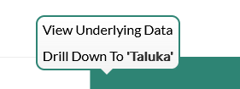
Dashboard
Progress Milestone

Slide 23
Dashboard
Work Status – “New” Schemes
Work Status – “Retro” Schemes

Slide 24
MS Project
Work in Progress Schemes

Slide 25
Sample Site Visit Photos

Slide 26
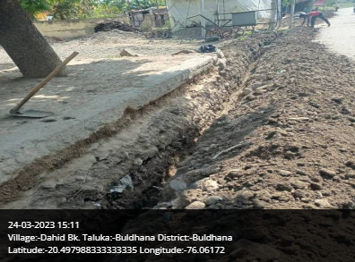
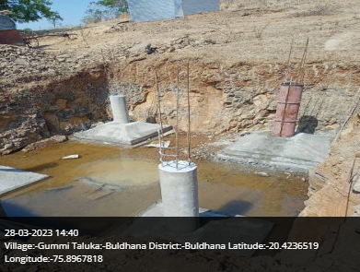
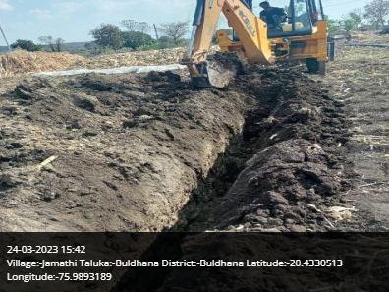
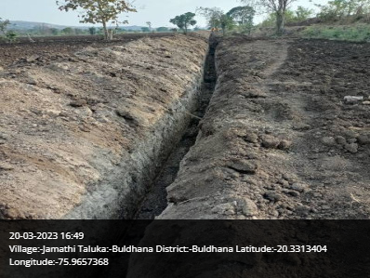
Buldhana Taluka

Slide 27
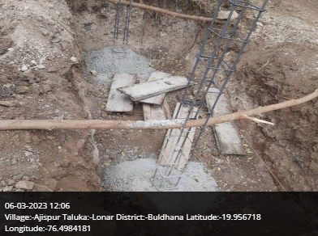
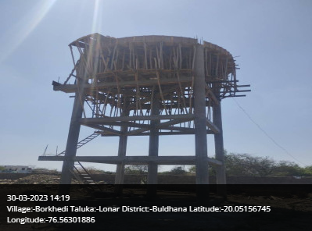
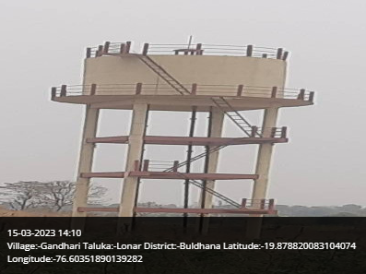
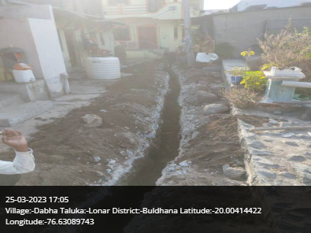
Lonar Taluka

Slide 28
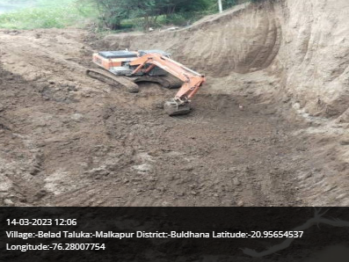
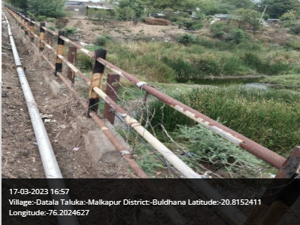
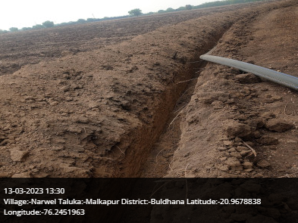
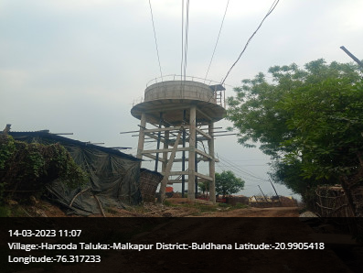
Malkapur Taluka

Slide 29
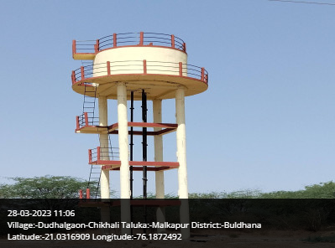
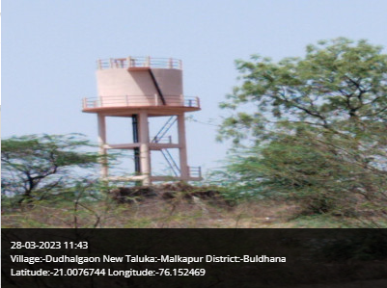
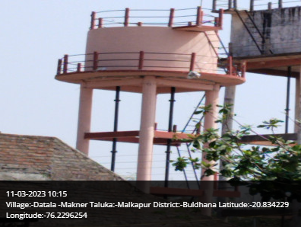
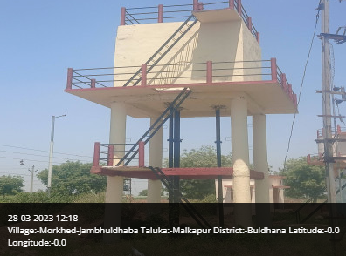
Malkapur Taluka

Slide 30
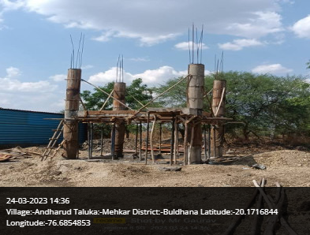
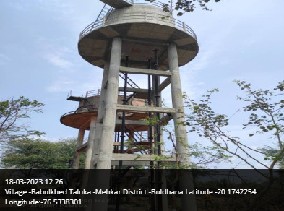
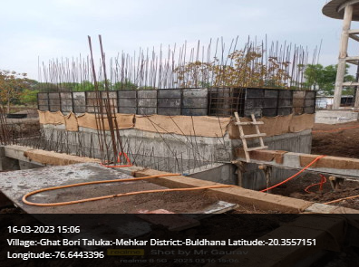
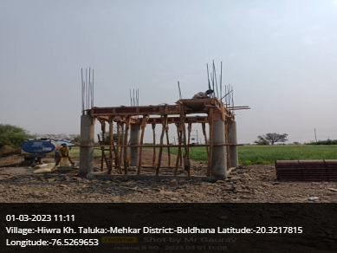
Mehkar Taluka

Slide 31
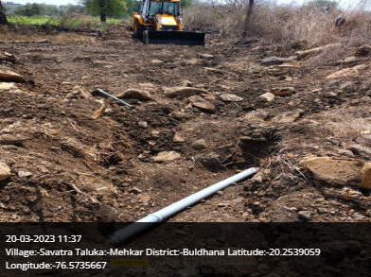
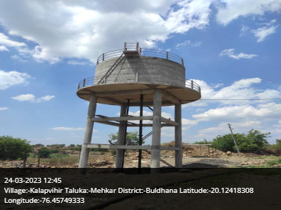
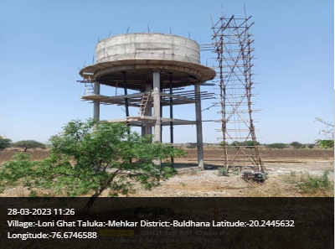
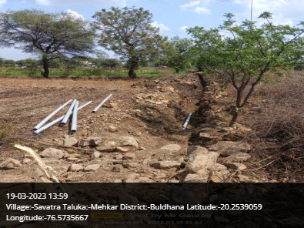
Mehkar Taluka

Slide 32
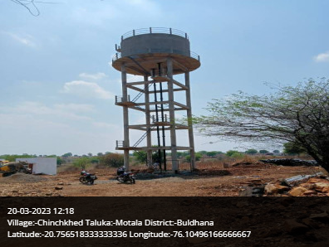
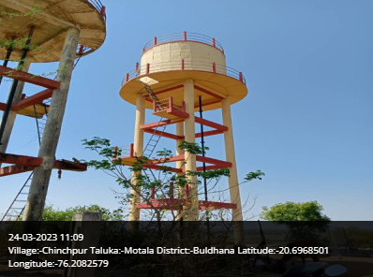
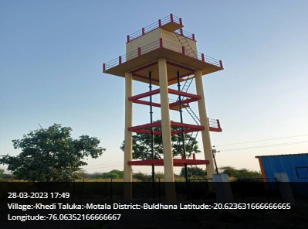
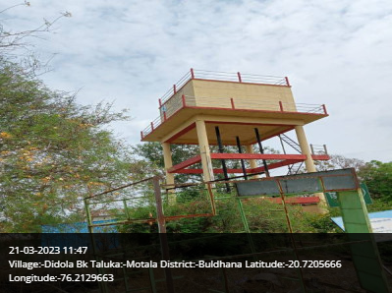
Motala Taluka

Slide 33
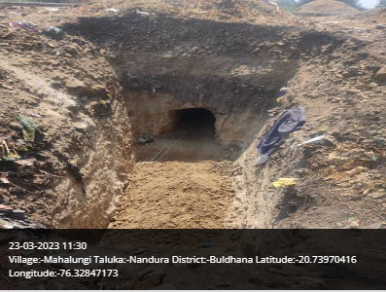
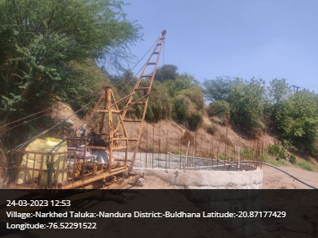
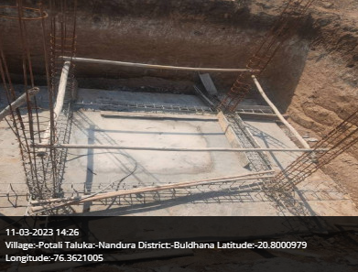
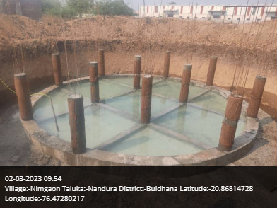
Nandura Taluka

Slide 34

Thank You!

